Slide 1
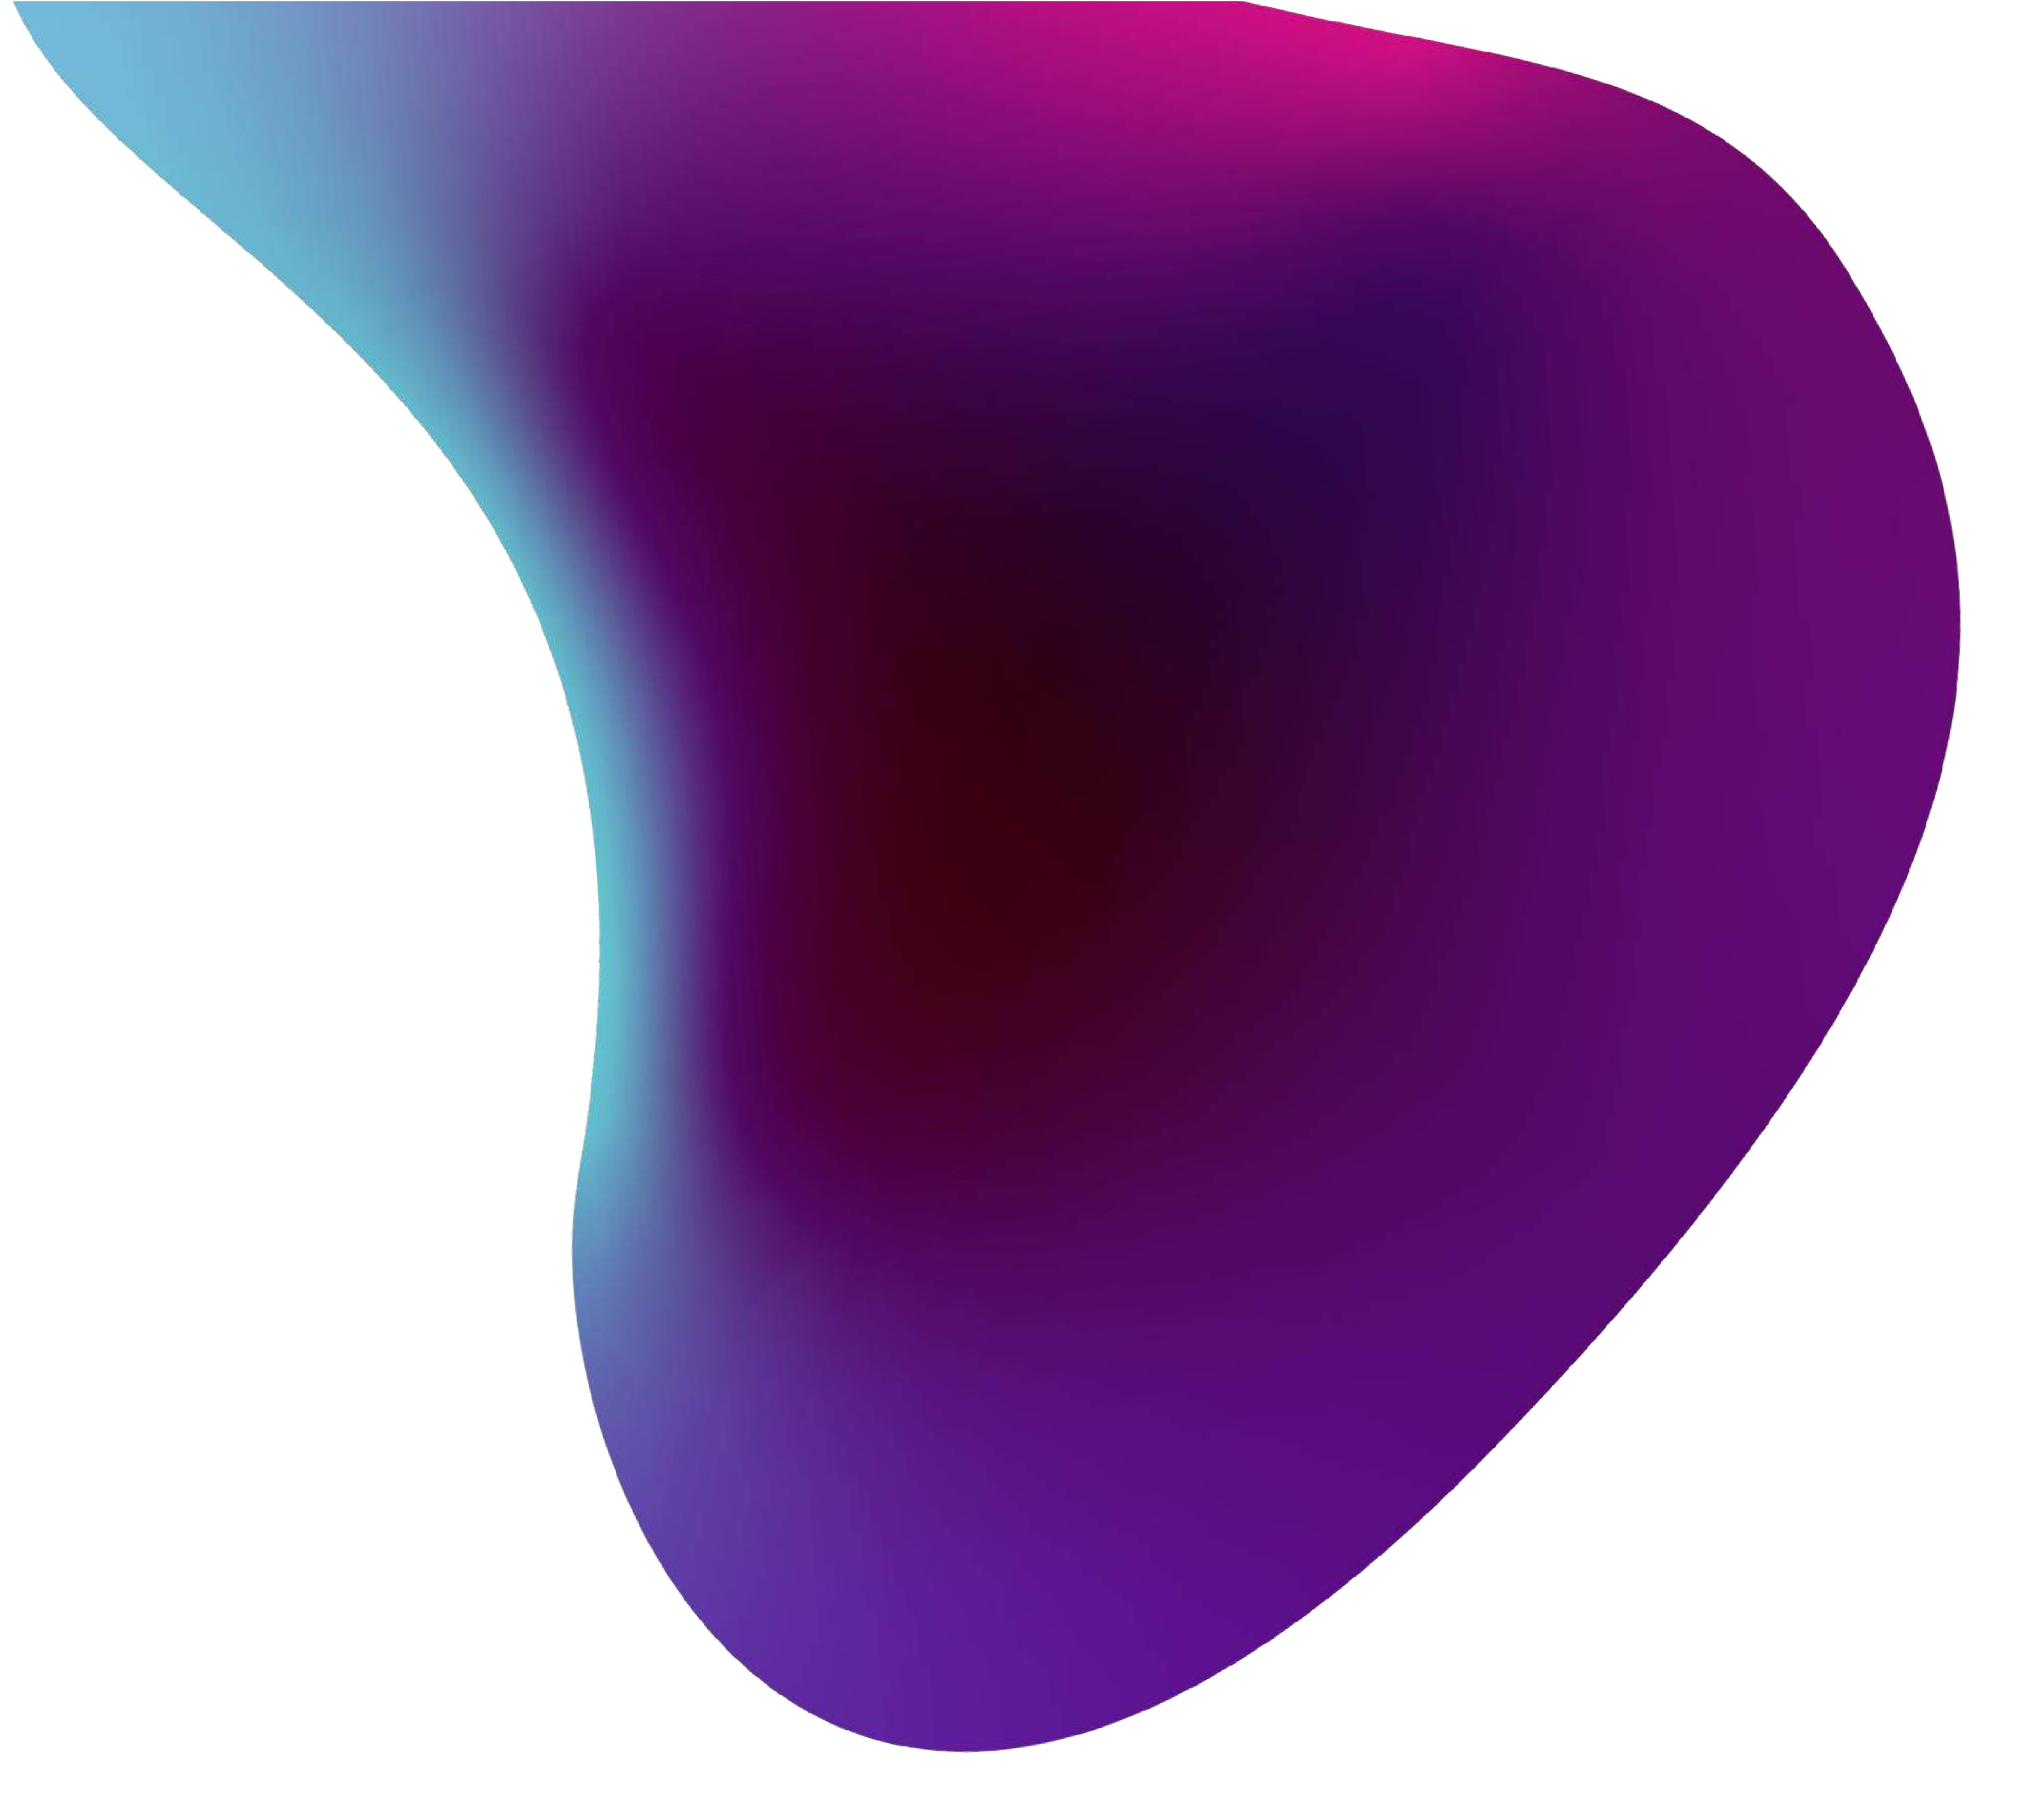
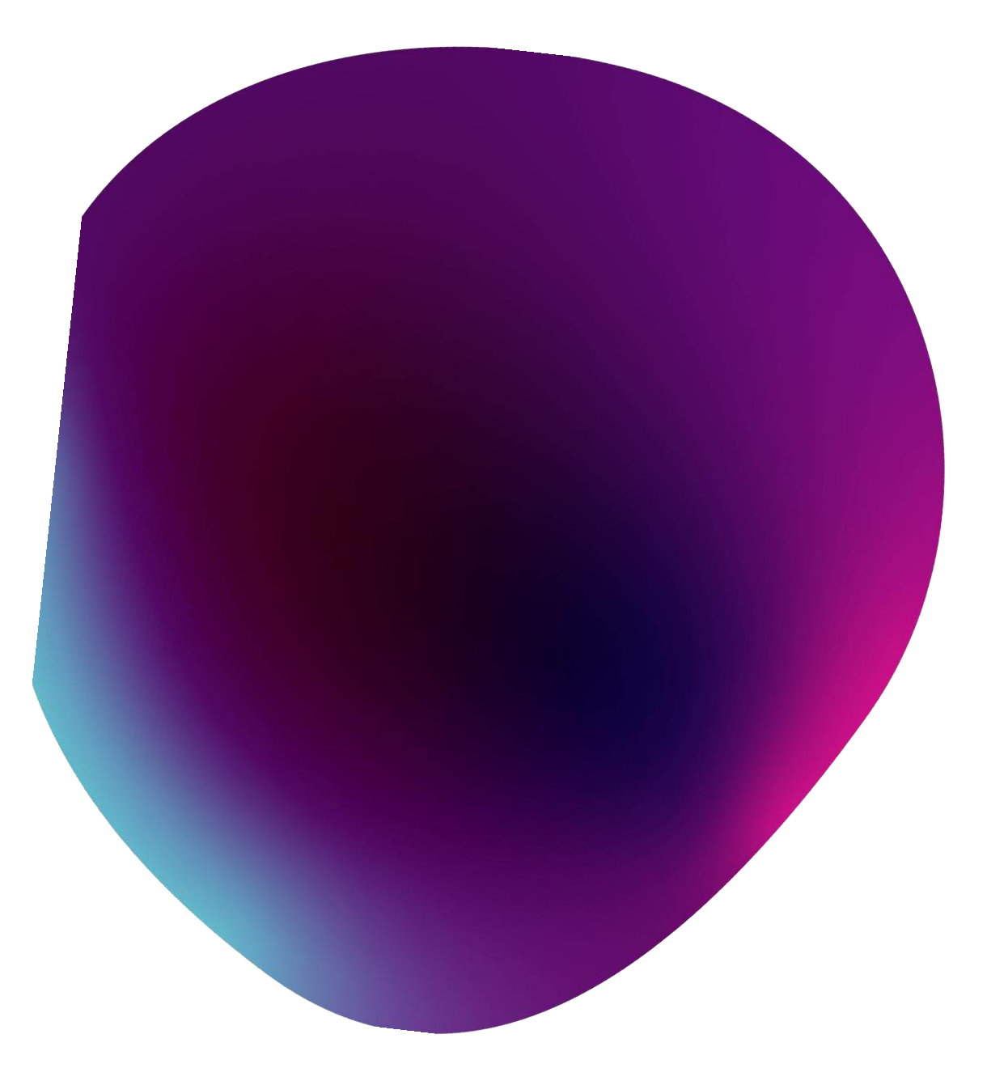






Slide 2
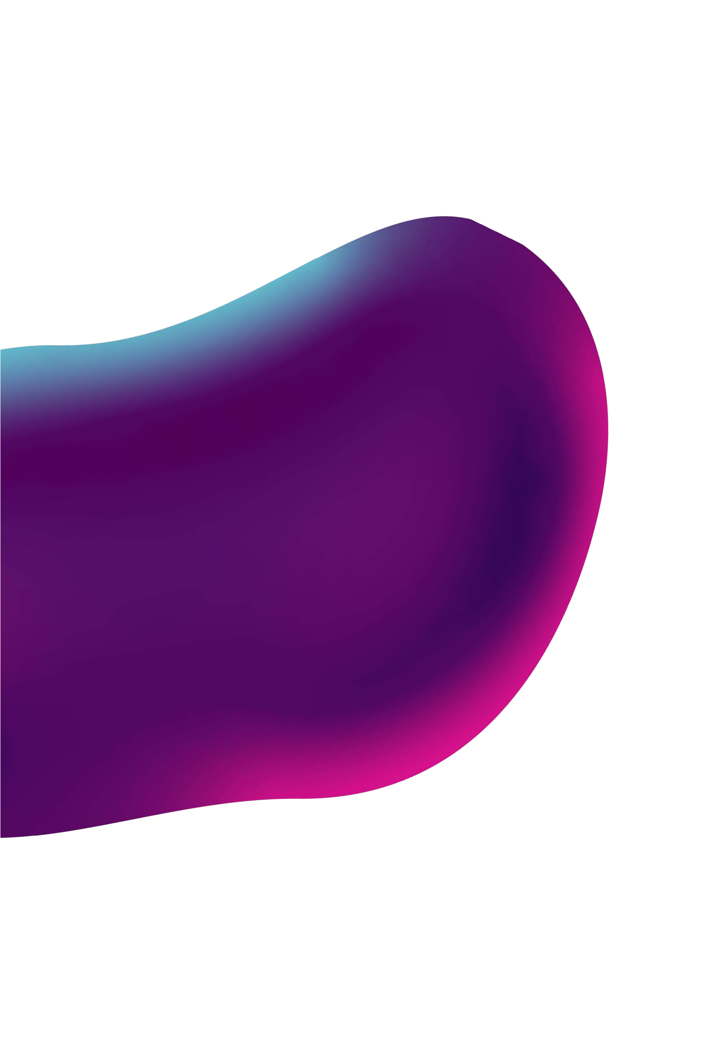
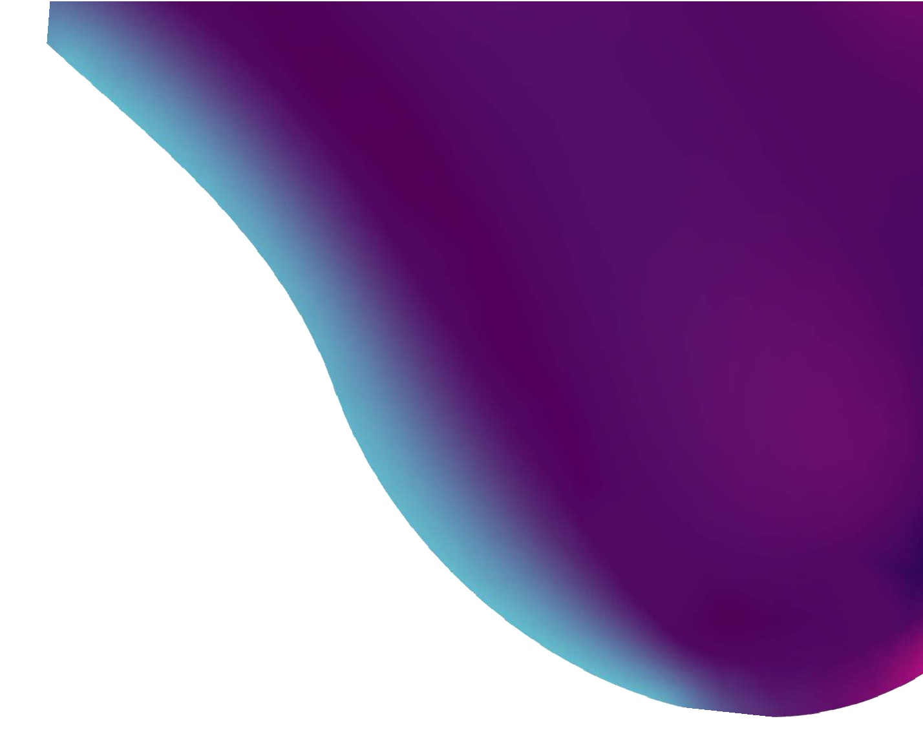



Design a system for real-time sign language interpretation using a webcam, enabling seamless communication for individuals with hearing and speech impairments.

Slide 3

Objective
Develop a real-time hand gesture recognition system using TensorFlow and OpenCV, with a focus on high accuracy, low-latency processing, and versatility for applications like human-computer interaction and sign language interpretation.
Scope
Data preparation, model development, OpenCV integration, user-friendly interface design, performance optimization, testing, documentation, and potential future enhancements.

Slide 4
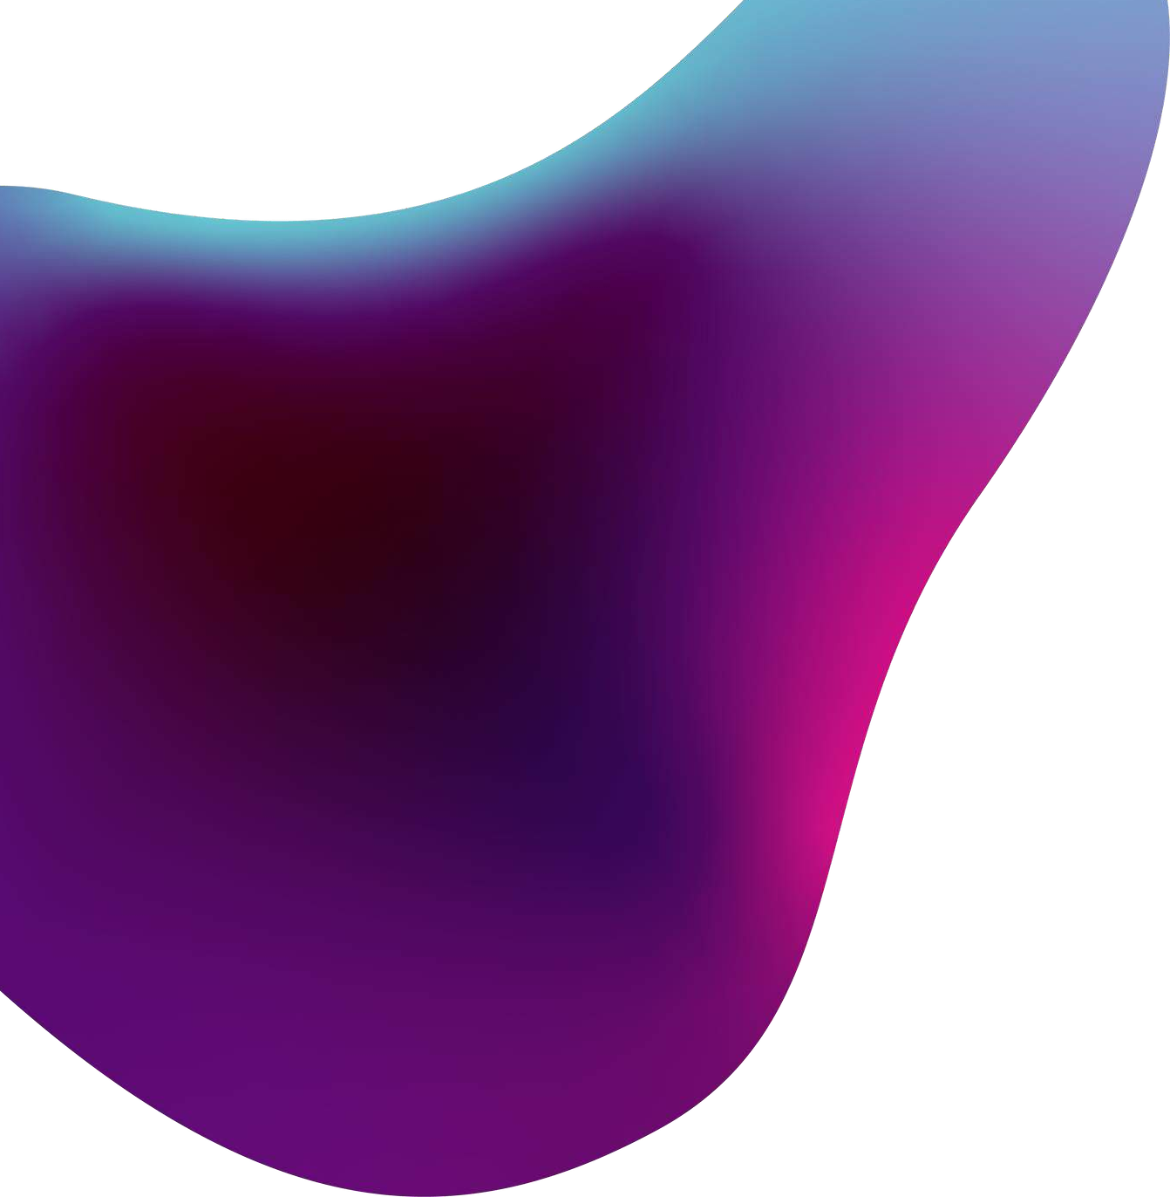
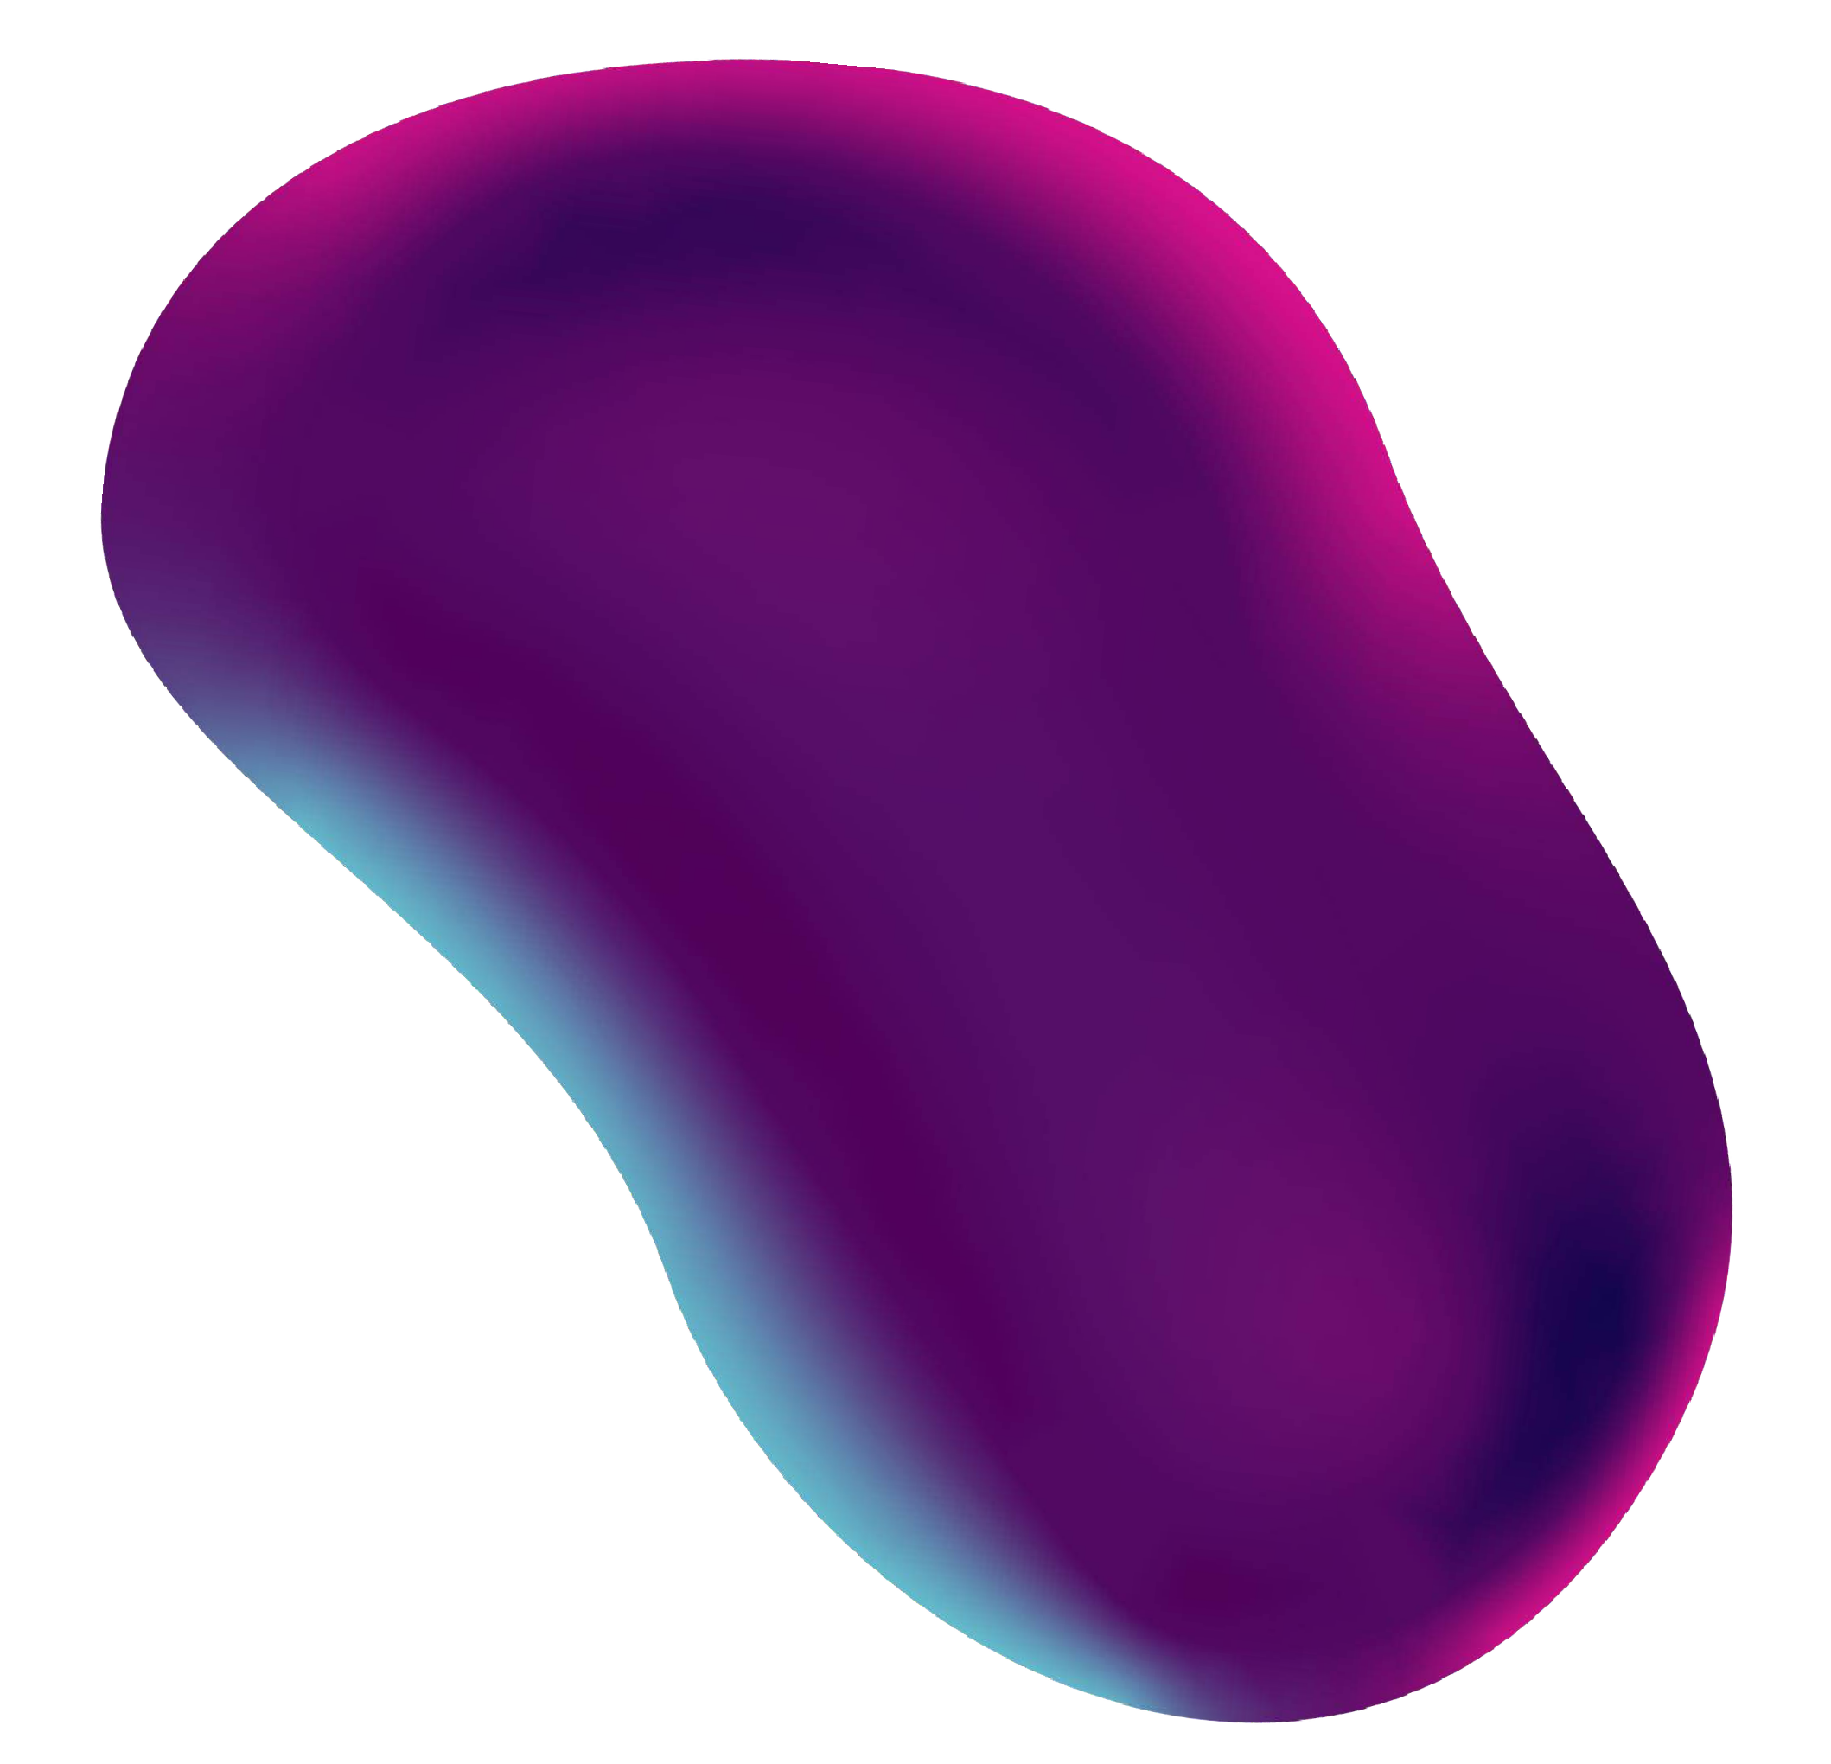

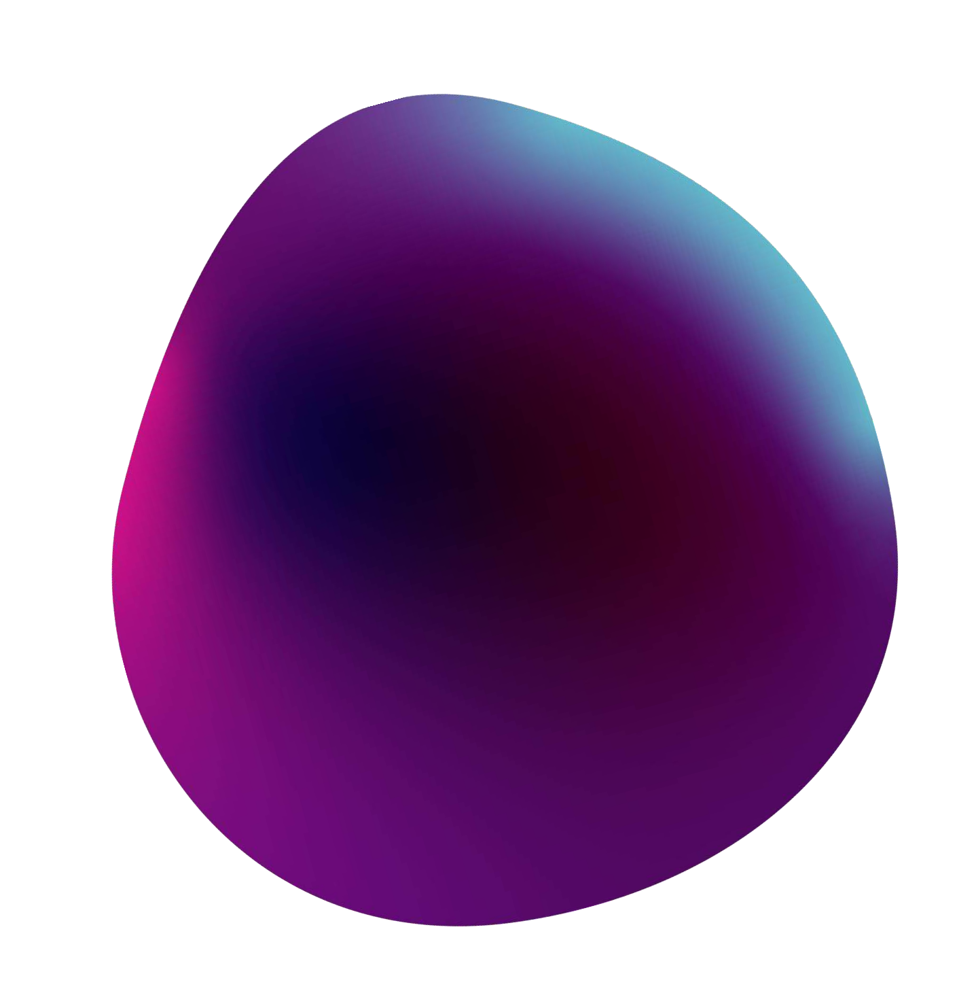

Slide 5






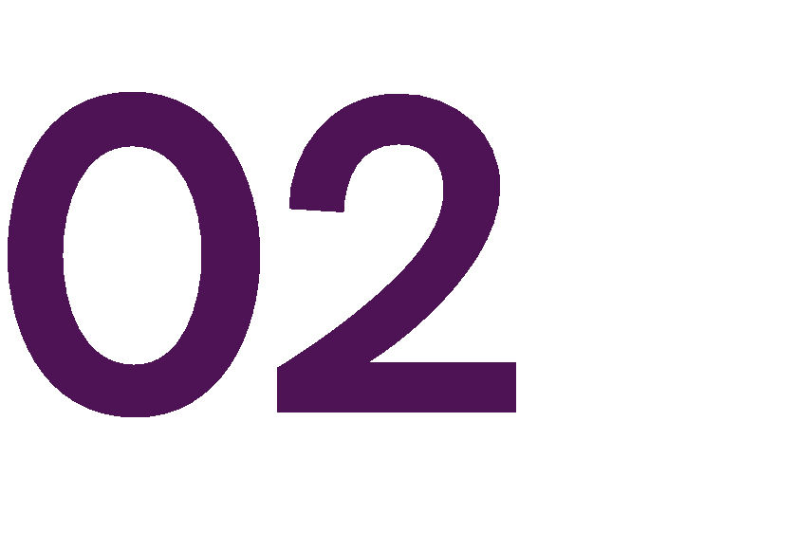




Slide 6

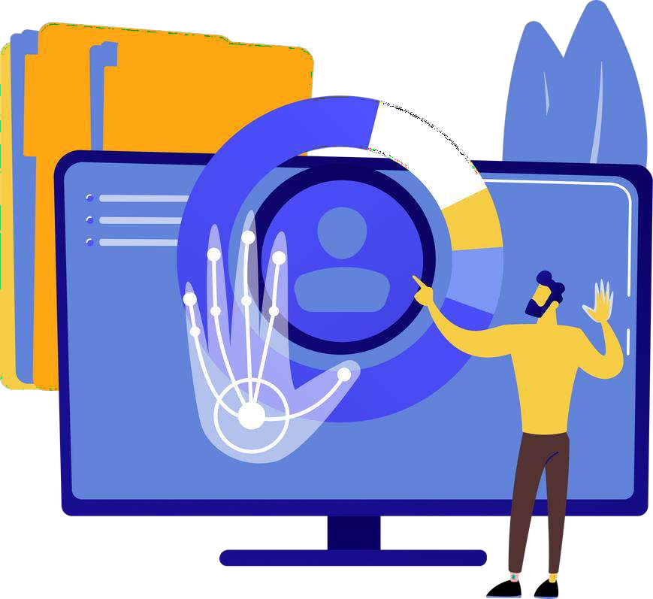
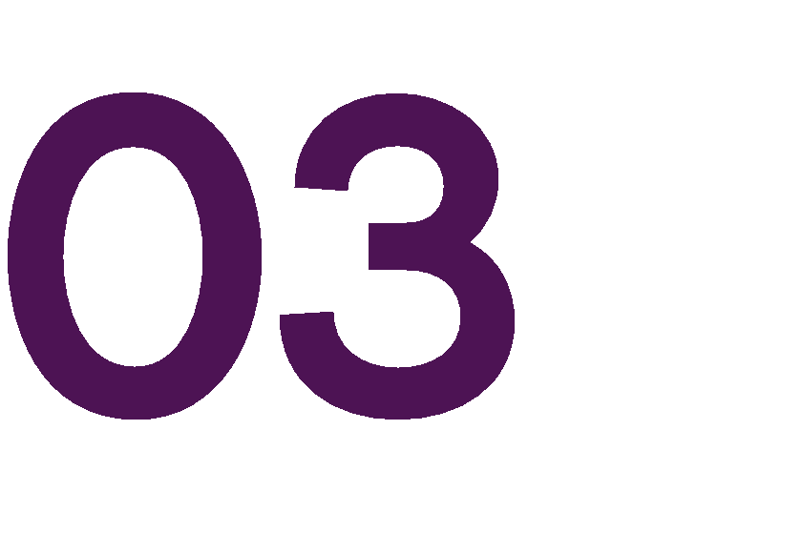








Slide 7












Slide 8


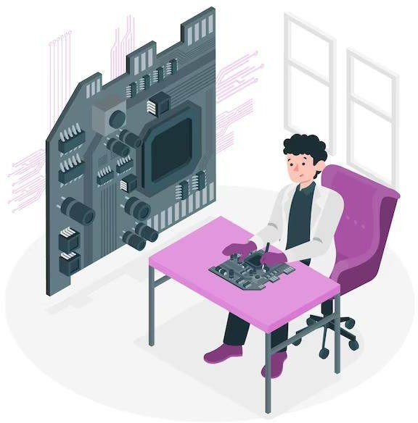



High-resolution camera (webcam, smartphone).
GPU (optional, for accelerated processing).
Powerful CPU and ample RAM (8GB+).
Operating system (Ubuntu).
Python with TensorFlow and OpenCV.
CUDA and cuDNN (NVIDIA GPU acceleration).
IDE (PyCharm, Visual Studio Code).

Slide 9


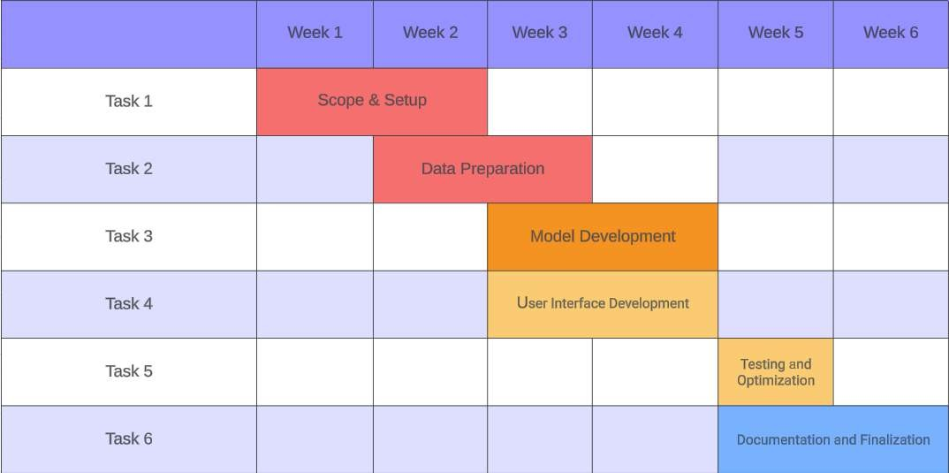


Slide 10


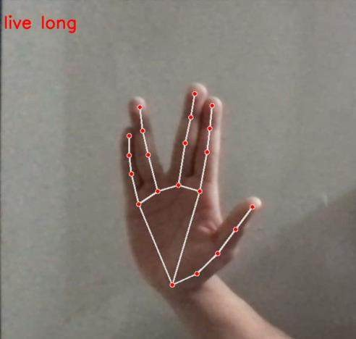
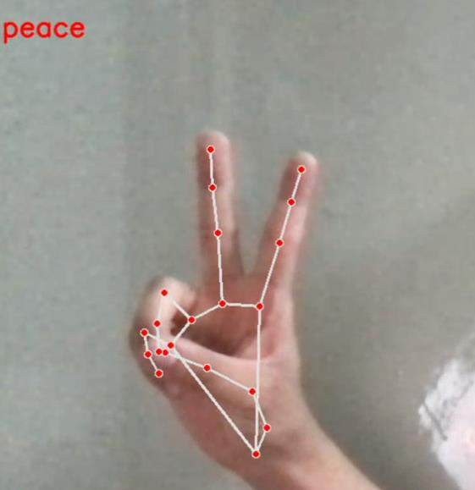







Slide 11
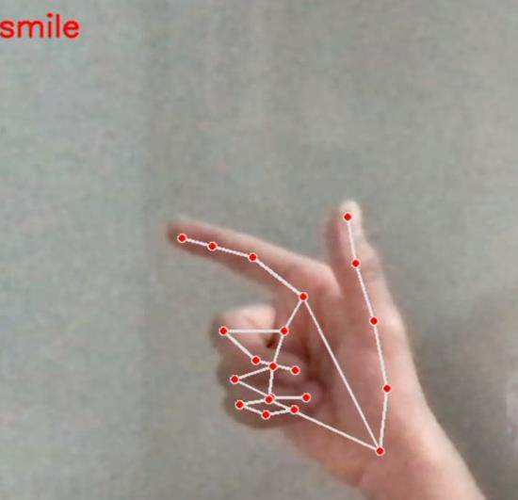
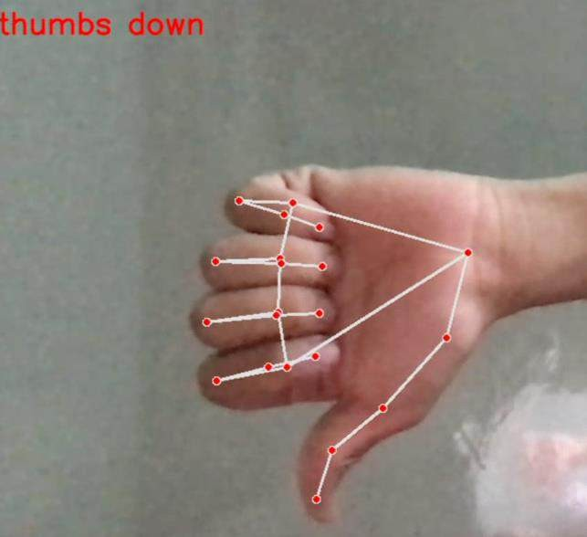



Slide 12
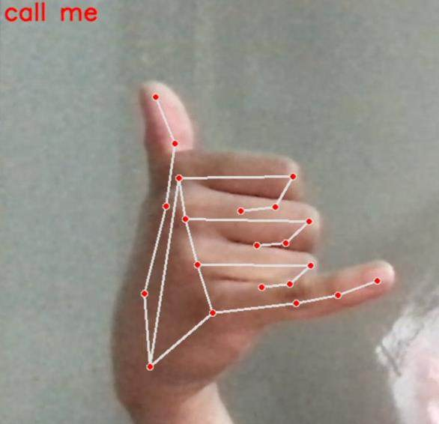
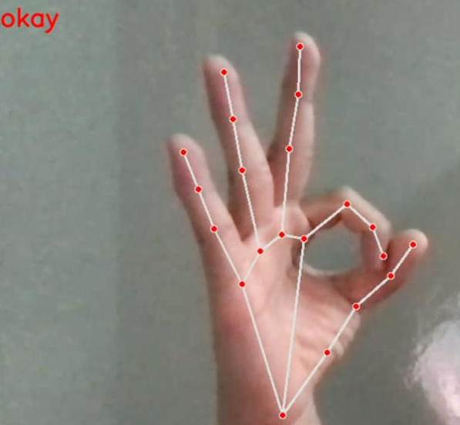



Slide 13
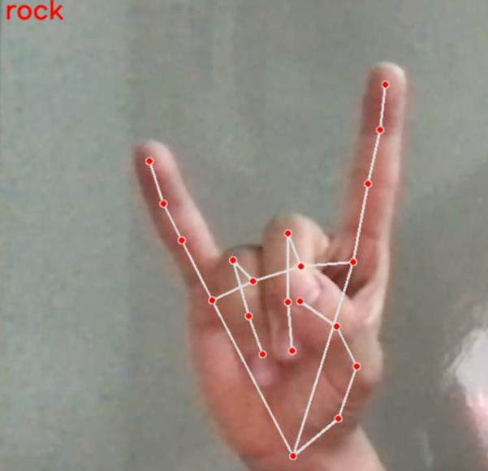
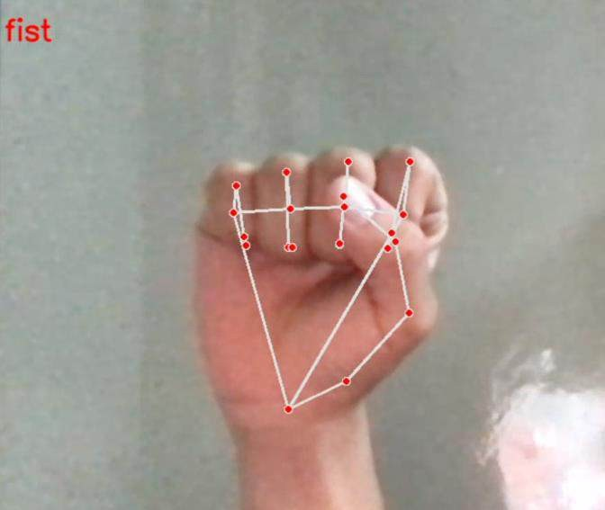



Slide 14
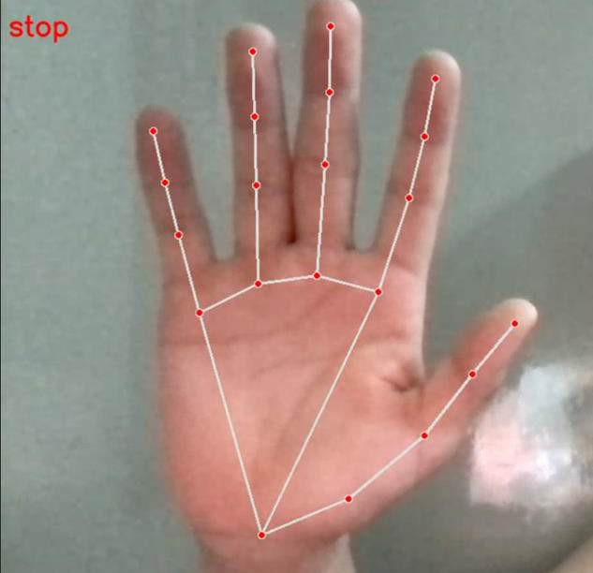
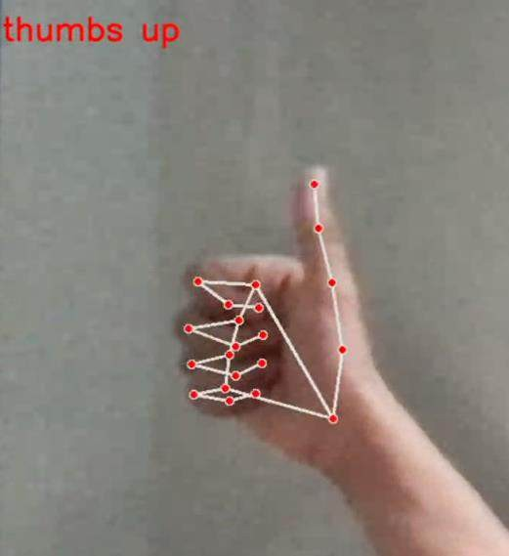




Slide 15





Real-time Hand Gesture Recognition using TensorFlow and OpenCV represents a significant step forward in human-computer interaction. The fusion of deep learning and computer vision technologies holds great promise for the evolution of intuitive and immersive computing experiences, paving the way for a more interconnected and accessible digital future

Slide 16




